Slide 1


Credit Card Fraud Detection

Slide 2
Index
Introduction
Methodology
Innovations in project

Slide 3
Introduction
'Fraud' in credit card transactions is unauthorized and unwanted usage of an account by someone other than the owner of that account. Necessary prevention measures can be taken to stop this abuse and the behaviour of such fraudulent practices can be studied to minimize it and protect against similar occurrences in the future.
Credit Card Fraud can be defined as a case where a person uses someone card issuing authorities are unaware of the fact that the card is being used.Fraud detection involves monitoring the activities of populations of users in order to estimate, perceive or avoid objectionable behaviour, which consist of fraud, intrusion, and defaulting.
Machine learning algorithms are employed to analyse all the authorized transactions and report the suspicious ones. These reports are investigated by professionals who contact the cardholders to confirm if the transaction was genuine or fraudulent. The investigators provide a feedback to the automated system which is used to train and update the algorithm to eventually improve the fraud-detection performance over time. Feasibility Study It is vital that credit card companies are able to identify fraudulen

Slide 4
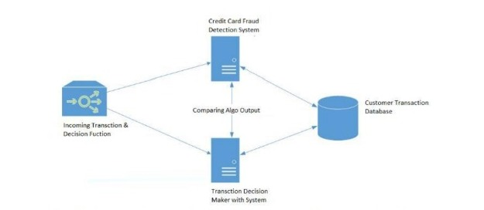
METHODOLOGY
The approach that this paper proposes, uses the latest machine learning algorithms to detect anomalous activities, called outliers. The basic rough architecture diagram can be represented with the following figure:

Slide 5
Innovations in project
we did end up creating a system that can, with enough time and data, get very close to that goal. As with any such project, there is some room for improvement here. The very nature of this project allows for multiple algorithms to be integrated together as modules and their results can be combined to increase the accuracy of the final result.
This provides a great degree of modularity and versatility to the project. More room for improvement can be found in the dataset. As demonstrated before, the precision of the algorithms increases when the size of dataset is increased.

Slide 6
IMPLEMENTATION
This idea is difficult to implement in real life because it requires the cooperation from banks, which aren’t willing to share information due to their market competition, and also due to legal reasons and protection of data of their users. Therefore, we looked up some reference papers which followed similar approaches and gathered results.As stated in one of these reference papers.
All individuals mentioned in this list had their cards closed to avoid any risk due to their high-risk profile. The condition is more complex for the other list. The level 2 list is still restricted adequately to be checked on a case by case basis. Credit and collection officers considered that half of the cases in this list could be considered as suspicious fraudulent behaviour. For the last list and the largest, the work is equitably heavy.

Slide 7
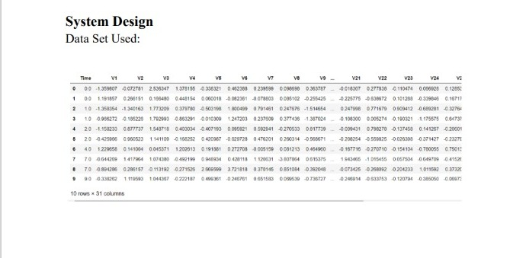
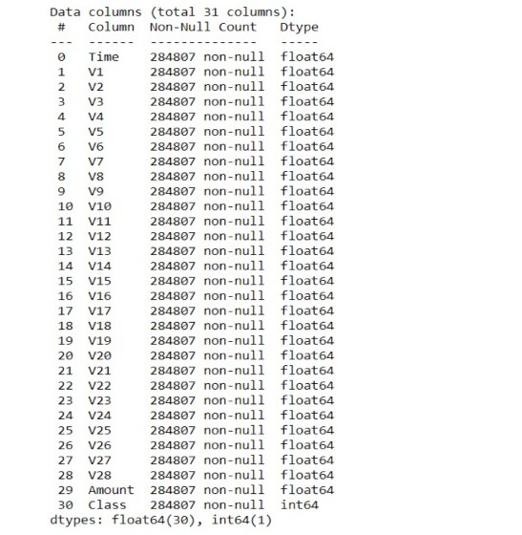
Code

Slide 8
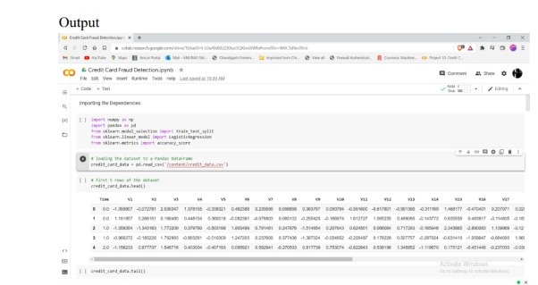
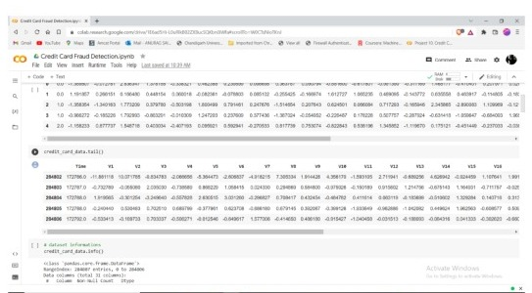
OUTPUT

Slide 9
THANK YOU

